Slide 1

Maxes Music Matcher

Slide 2

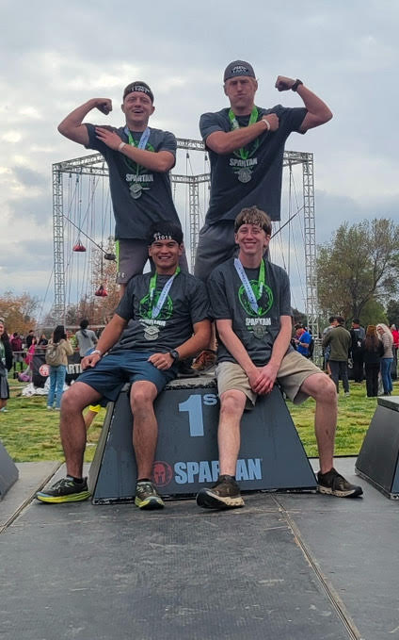
Betsy
Jesse
Jesse

Slide 3
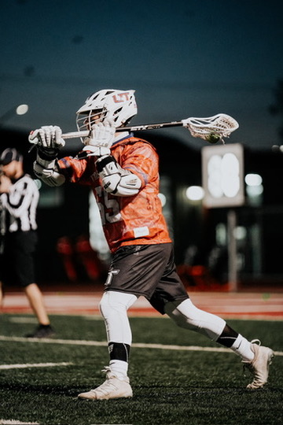
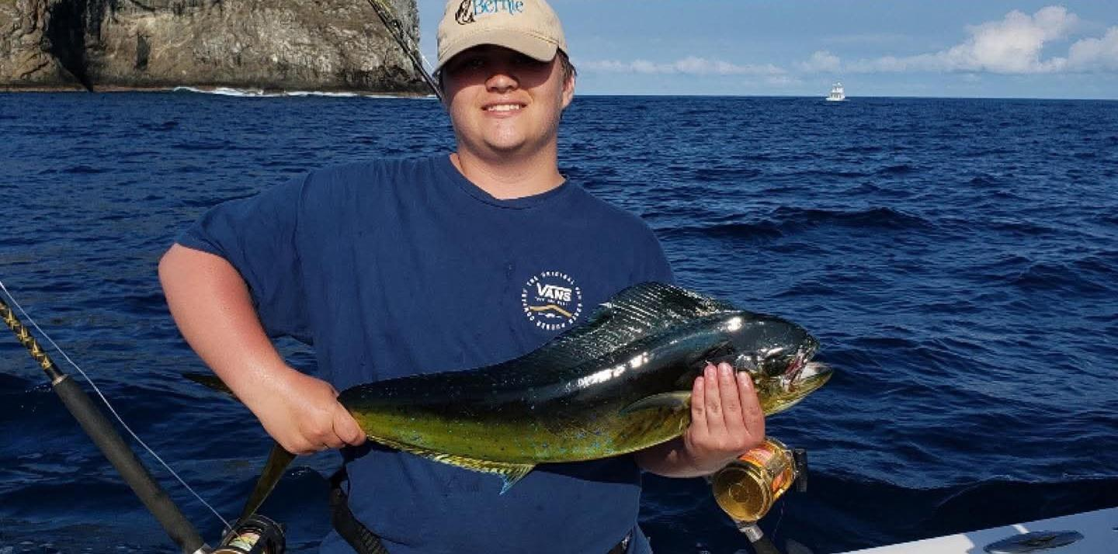
Mason
Max
Jesse

Slide 4
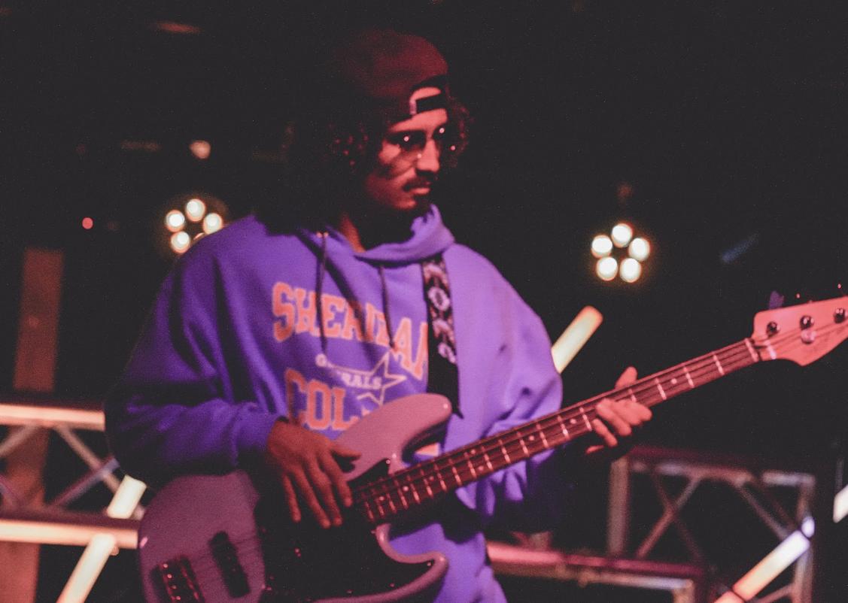
Bryce Taylor
I play in a reggae band
They call me master bass
From Sheridan, WY

Slide 5

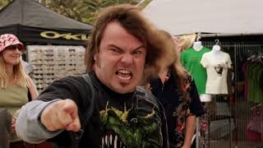
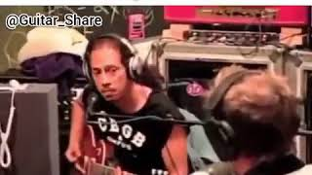
Overview
In a world with millions of musicians, it can seem nearly impossible to find like-minded musicians with similar interests and expertise.
5 common problems looking for a band:
Goals
Conflict with Genres
Schedule/availability for gigs and practices
Personality clashes
Levels of experience
Musicians view their music as a hobby or a job.
Depending on what they’re looking for, our app will allow them to:
Create a professional profile/resume
View other musicians. Set filters to tailor searches to their needs
Communicate with matches through DM
Combine profiles to symbolize you’ve become a band
Bryce

Slide 6
In-Scope 1.0
A profile system
Attach video samples for others to see
Photos
Band affiliation
Genre
A way to filter users
Location
Genre
Age
Instrument
A search bar to friend users
Direct messenger
Group Chats
Links to other socials
Spotify
Instagram
Notifications
Likes
Messages
Band Invites
Mobile and Web
Max

Slide 7
Out-of-Scope 1.0
High level sorting algorithm.
Allow users globally
Samples over 5 minutes
Limited to 10 pictures
Allow endless users on service
Kids version
Max

Slide 8
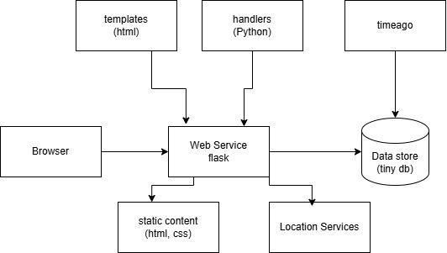
Components
Browser → Flask sends input to flask
Templates/Handles → Flask dynamic webpage
Flask → Data Store update/remove data
Flask → Static Content determines appearance
Flask → Location finds location of user
Jesse

Slide 9
Architecture
CSS
Color Adjustments
Potential Font Adjustments
CSS Method for Inputting images
HTML
Javascript Alerts/Notifications
Multiple Pages
Python
Lists for Friends
Classes for Liking/Disliking Profiles
Data Stores for Images/Videos
Data Store for Likes/Dislikes
Scroll Limit Code
Musician Verification System
Mason F

Slide 10
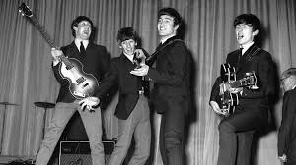


Sample Page
Example of a potential match
Shows profile + Bio
Two options: Rock On (match) or Rock Off (not a match)
Ability to scroll through photos, videos, audio samples
The profiles shown will be dependent on user filters. Profiles that have already liked/matched with a user will also appear in this stage, or be otherwise accessible through the user’s profile.
Name: The Beatles
Genre: Rock
Located: Liverpool, England
Years of Experience: 10
Uses: Guitar, Bass, Drums
Looking for a fifth member to join the band!
Rock on!!!
Rock oFF...
Betsy

Slide 11
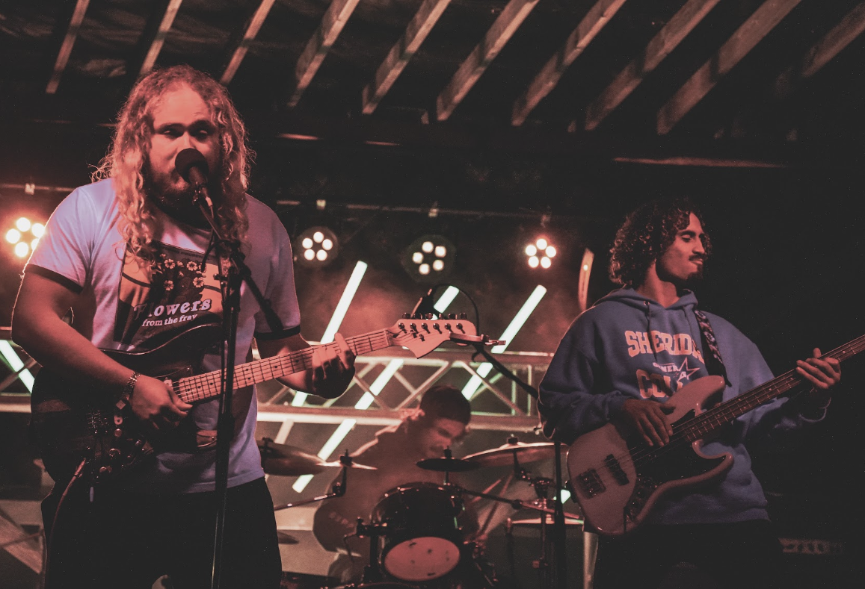
Summary
Many musicians in the world are lost when it comes to finding like-minded people to play music with. Maxes Music Matcher will be the platform musicians use to find the band they were meant to play with. With the right resources and the slightest amount of curiosity, musicians can use our app to spark a whole new world of creativity. Whether you’re shooting for the stars to get famous, or looking for somebody to play music by fire, Maxes Music Matcher is the app for YOU.
Mason F and Bryce

Slide 12

Questions
And Answers
Jesse

